Slide 1
Data Structure and Algorithm CSE- 225
Dr. Mohammad Abu Yousuf
yousuf@juniv.edu

Slide 2
Single-Source Shortest Paths

Slide 3
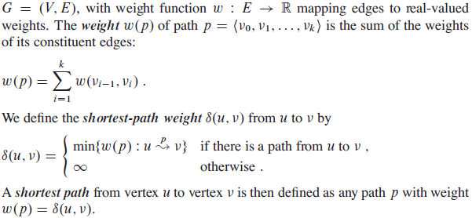
Single-Source Shortest Paths

Slide 4
Single-Source Shortest Paths
we shall focus on the single-source shortest-paths problem: given a graph G =(V, E), we want to find a shortest path from a given source vertex s ϵ V to each vertex v ϵ V .

Slide 5
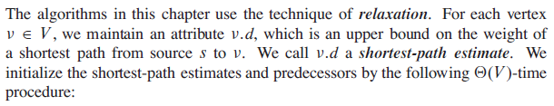
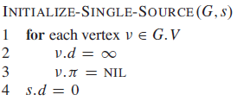
Single-Source Shortest Paths
Relaxation:
Here, each vertex v ϵ V a predecessor v.π that is either another vertex or NIL.

Slide 6

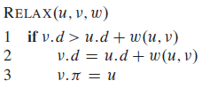
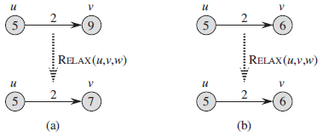
Single-Source Shortest Paths

Slide 7
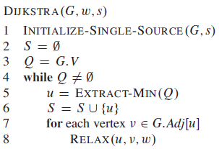
Single-Source Shortest Paths
Dijkstra’s algorithm:
Dijkstra’s algorithm solves the single-source shortest-paths problem on a weighted, directed graph G = (V,E) for the case in which all edge weights are nonnegative.

Slide 8
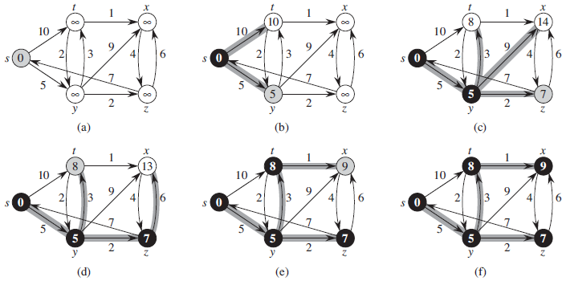
Dijkstra’s algorithm

Slide 9
Dijkstra’s algorithm:Example
u
v
∞
1
∞
10
9
2
3
s
0
4
6
5
7
∞
∞
2
x
y

Slide 10
Dijkstra’s algorithm: Example
u
v
10
1
∞
10
9
2
3
s
0
4
6
5
7
5
∞
2
x
y

Slide 11
Dijkstra’s algorithm:Example
u
v
8
1
14
10
9
2
3
s
0
4
6
5
7
5
7
2
x
y

Slide 12
Dijkstra’s algorithm: Example
u
v
8
1
13
10
9
2
3
s
0
4
6
5
7
5
7
2
x
y

Slide 13
Dijkstra’s algorithm:Example
u
v
8
1
9
10
9
2
3
s
0
4
6
5
7
5
7
2
x
y

Slide 14
The Bellman-Ford algorithm
The Bellman-Ford algorithm solves the single-source shortest-paths problem in the general case in which edge weights may be negative.
Given a weighted, directed graph G =(V,E) with source s and weight w, the Bellman-Ford algorithm returns a boolean value indicating whether or not there is a negative-weight cycle that is reachable from the source.
If there is such a cycle, the algorithm indicates that no solution exists. If there is no such cycle, the algorithm produces the shortest paths and their weights.

Slide 15
The Bellman-Ford algorithm
The algorithm relaxes edges, progressively decreasing an estimate v.d on the weight of a shortest path from the source s to each vertex v until it achieves the actual shortest-path weight δ(s,v).
The algorithm returns TRUE if and only if the graph contains no negative-weight cycles that are reachable from the source.

Slide 16
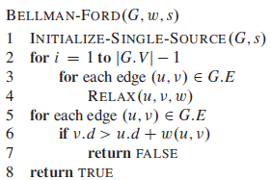
The Bellman-Ford algorithm

Slide 17
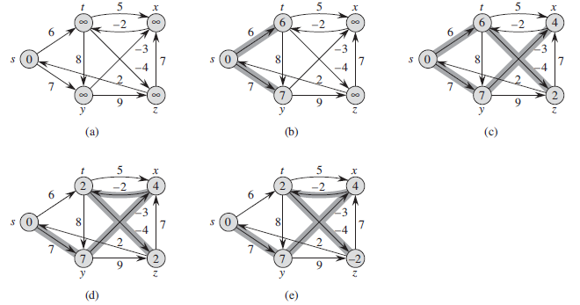
The Bellman-Ford algorithm

Slide 18
Thank you

